Slide 1
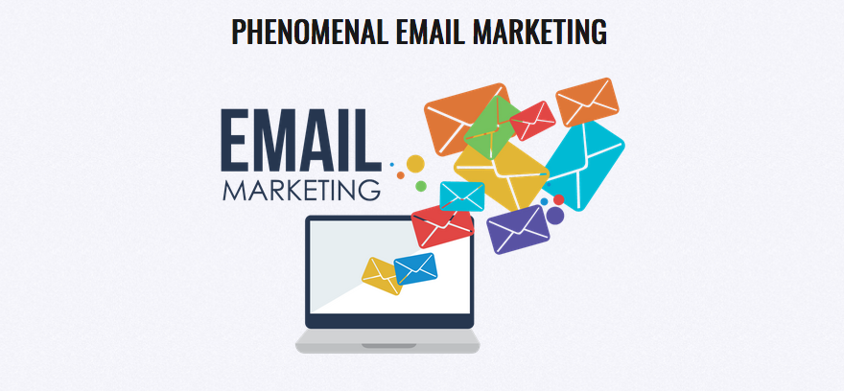
The Howard Partridge Inner Circle
Inspiration to Implementation

Slide 2
Icebreaker
Who are you? What do you do?
Do you currently have an e-mail list?

Slide 3
Information

Slide 4
Why E-Mail Marketing?
Biggest Marketing Mistake of ALL
The Fortune is in the Follow Up
Almost Free
Immediate
TOMA
Build the Experience
Position Yourself
Upgrade Leads and Customers

Slide 5
The Course
Build the List
Choose Your Software
Your Campaign Strategy
Write Copy that Sells
Check the Stats
Opt-In Offers
Segment the List
DEALagate this Task

Slide 6
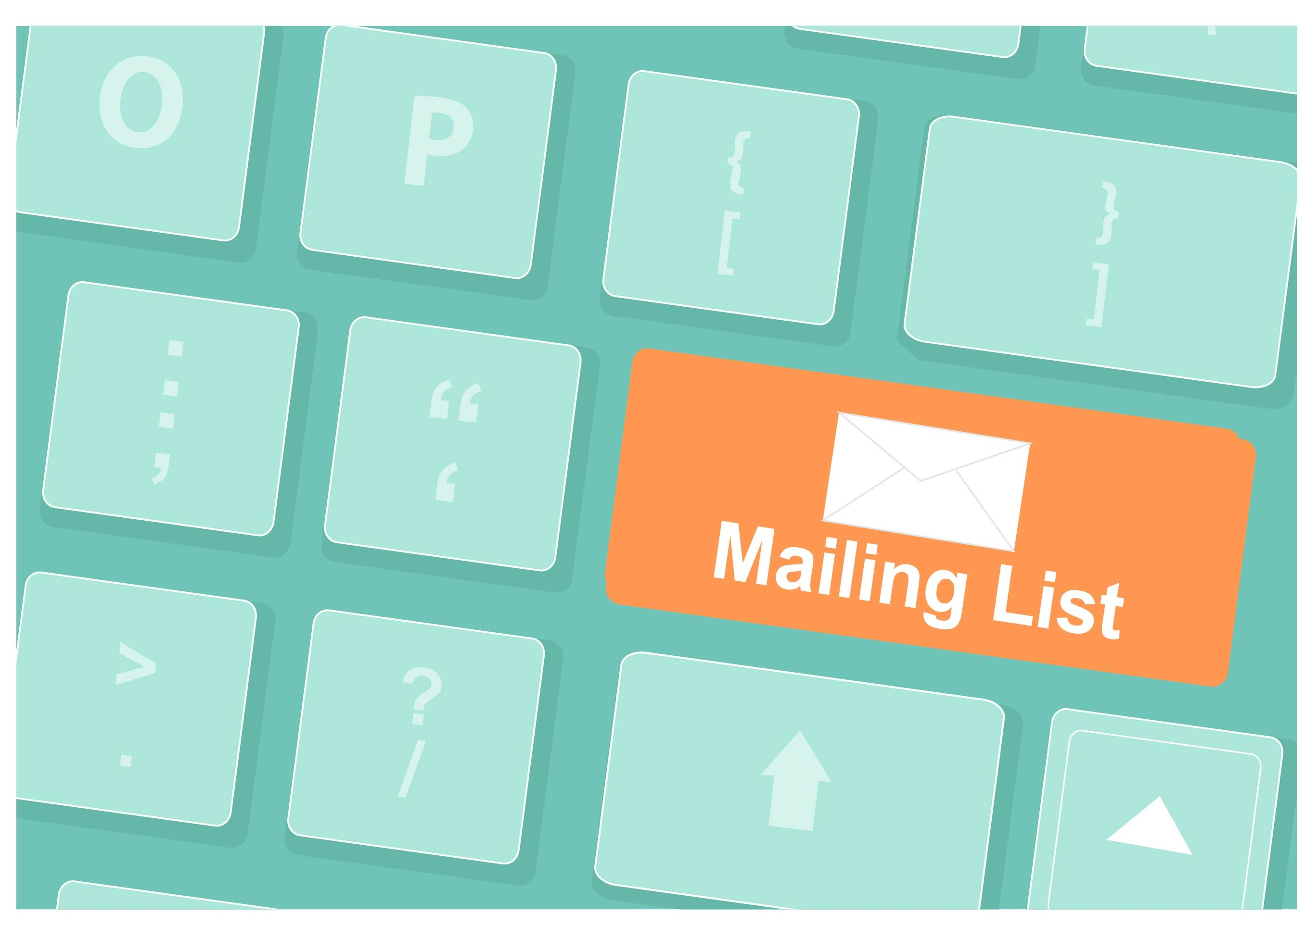
Build the List
The Money is in the LIST
Who is Your Perfect Target Market?
ALWAYS Get Permission!
Adhere to CAN-SPAM Act
GDPR Notice
Use a Broadcast Software Program
*This is NOT Legal Advice!

Slide 7
Build the List
Start with Existing Clients
With Every Order
E-Mail Signature
Calling Program
Mailing Program
Retarget Online
Existing Social Media
Add Prospects During the Inquiry Stage
Website Opt-In

Slide 8
Build the List
Referral Sources/Affiliates!
Clients Share Your Opt-In
Networking
Speaking
Online Ads (FB, Banners)
Retargeting Ads
Blogs/Podcasts
Print Ads
Trade Shows
Do NOT buy a list!

Slide 9
Interaction
What strategies are you using to build your list?

Slide 10
Implementation
What strategies will you add this week?

Slide 11
Inspiration
“You can have everything in life you want, if you just help enough other people get what they want”
- Zig Ziglar

