Slide 1
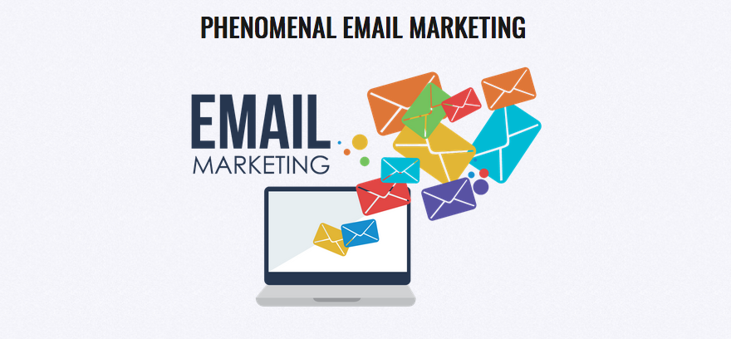
The Howard Partridge Inner Circle
Inspiration to Implementation

Slide 2
Icebreaker
What software do you use and why?

Slide 3
Information

Slide 4
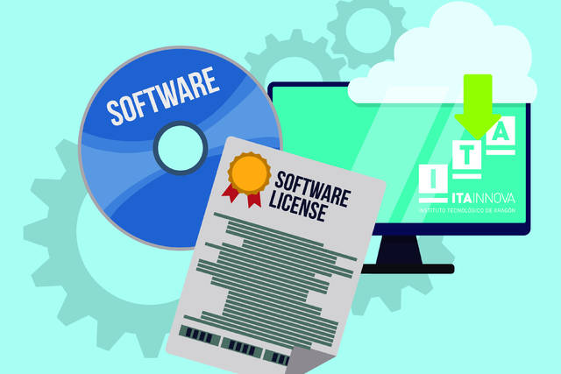
Software Considerations
E-Mail
Autoresponder
Segmentation
CRM ($$$, billing, etc.)
Campaigns
Automation

Slide 5
Why I use Infusionsoft
Tags – Easy Segmentation
Autoresponders
Automated Campaigns
CRM
Sales Reports

Slide 6
How I do it
I come up with a promotion
Team creates and deploys the e-mail
I check the stats weekly
If it is a campaign, I outline it
Team creates the internal opt-in form
Team creates the internal campaign parts
We monitor on team meeting weekly

Slide 8
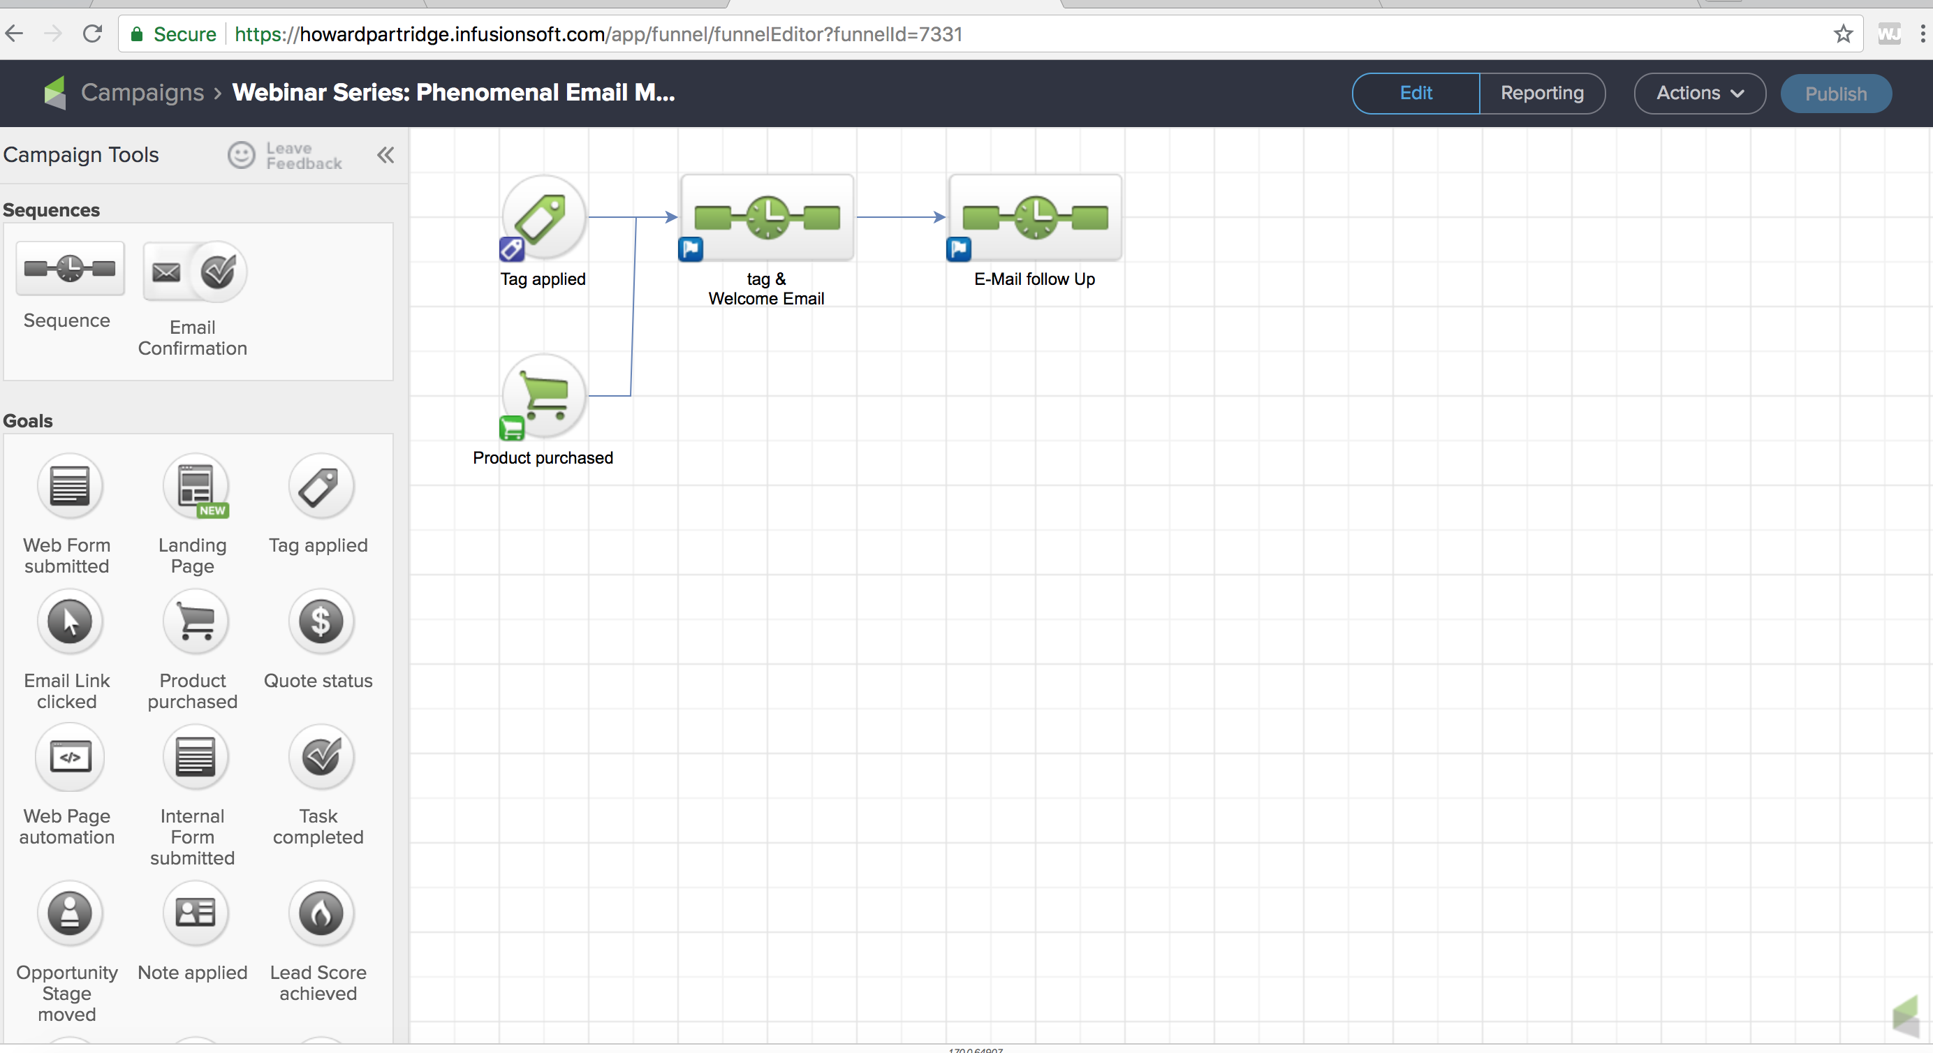

Slide 9
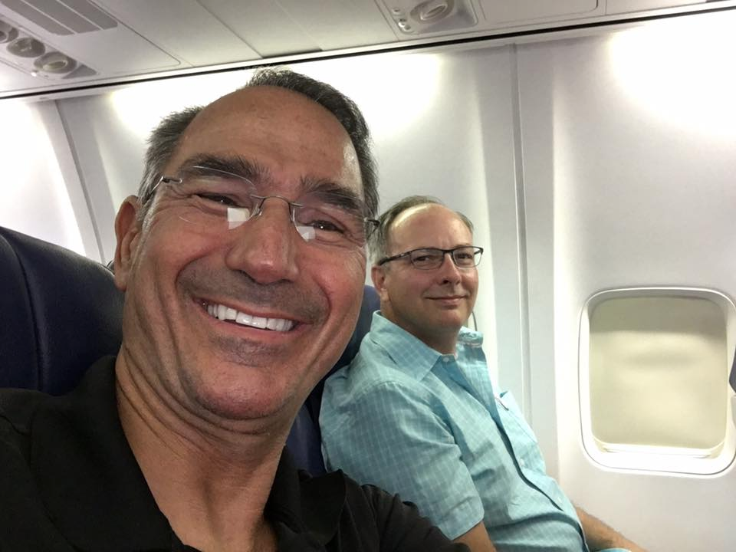
How to do it
Start Simple Dimple
Get the hang of e-mails first
Then move to a simple opt-in
Then move to more complex campaigns
Understand it, but don’t try to do it all

Slide 10
Interaction
What questions or observations
do you have?

Slide 11
Implementation
What is your next step?

Slide 12
Inspiration

